Slide 1
Customer Behavior Analysis
Minimize Customer Churn Rate in Banks
Group 2
Jingyi Zhang

Slide 2
Contents
02
04
Background of the Dataset
Methods & Results
01
Rui Lu
03
Yiming Chen; Jingyi Zhang; Chenyun Wan
05
Goal of the Analysis
Descriptive Statistics
Conclusion
Yinghan Liu
Xiaowen Zhang
Bingyue Li

Slide 3
Goal of the Analysis
01
Notes:
1.通常情况下你为什么想注销银行账号？
The customer service is poor? The fees are unforgivably high?Interest rates of loans are high? Or just No love for Long-Time clients?
2.注销账号给银行带来的损失
Lose customers. Lose source of money to issue loans. Break their fund chain. Go bankrupt.
3. 银行能不能提前辨别出可能注销账号的用户 to avoid the above horrible consequences?
The goal of our project is to use the clients information of a bank like EstimatedSalary, IsActiveMember, HasCrCard, NumOfProducts etc to find out whether a customer may exit the bank in the future. And then the bank could focus on these customers and take further actions to avoid the loss of customer.

Slide 4




Why Do You Want to Exit a Bank?
Interest Rate of Loans are High
Fees are Unforgivably High
Customer Service is Poor
Notes:
1.通常情况下你为什么想注销银行账号？
The bank’s customer service is very poor? The annual fees of cards are unforgivably high? The Interest rates of loans are high? Or you are just moving?

Slide 5



Loss of Bank Caused by Customer Exit
Go Brankrupt
Loss Customers
Loss Source of Money
Fund Chain Breaks
Notes:
2.注销账号给银行带来的损失
When customers exit a bank, there may have a series of negative effect on the bank.
First the bank just loses the customers. Then it starts to lose the source of money to issue loans, which may cause their fund chain breaking and finally even go bankrupt.

Slide 6
Goal of Our Analysis
01
Estimated Salary
02
Apr-Jun
Could banks distinguish the clients who might exit in the future through the info of...
Whether is Active Member
03
Jul-Sep
Whether has Credit Card
04
Number of Products
Notes:
3. 银行能不能提前辨别出可能注销账号的用户 to avoid the above horrible consequences?
So could banks distinguish the clients who might exit in the future to avoid the above horrible consequences?
The goal of our project is to use the clients information of a bank to find out whether a customer may exit the bank in the future, like the clients’ Estimated Salary, Whether Is an Active Member, Whether Has a Credit Card , the Number Of Products the client bought in this bank etc. And then the bank could focus on these clients and takes further actions to avoid the loss of these customer.

Slide 7
Background of the Dataset
02

Slide 8





Data Overview
Data is from Superdatascience.com
Why Leave and Switch
Better Service
Collected 10,000 Customers’ information from Bank Database
Sampling Method:
DecisionTree and KNN
Notes:
But why do we use this data? About six months ago, the bank found that more and more customers began to leave them to choose other banks. The bank's manager began to be aware of crisis. They want to use the data of each customer to predict which customers will leave the bank and transfer to other banks in the future. Once the manager knows this information, it can more targeted to save the customer and provide better service Six months ago, the manager chose 10,000 customers from its huge customer base. Then in the last six months, we have the result of whether the customer left the bank or not. Number 1 represents that customers have left our bank in the past six months. 0 represents that the customer ultimately stayed in the bank. Hence, our purpose is to want to help manager what are the characteristics of the customers will leave their bank in the future.

Slide 9
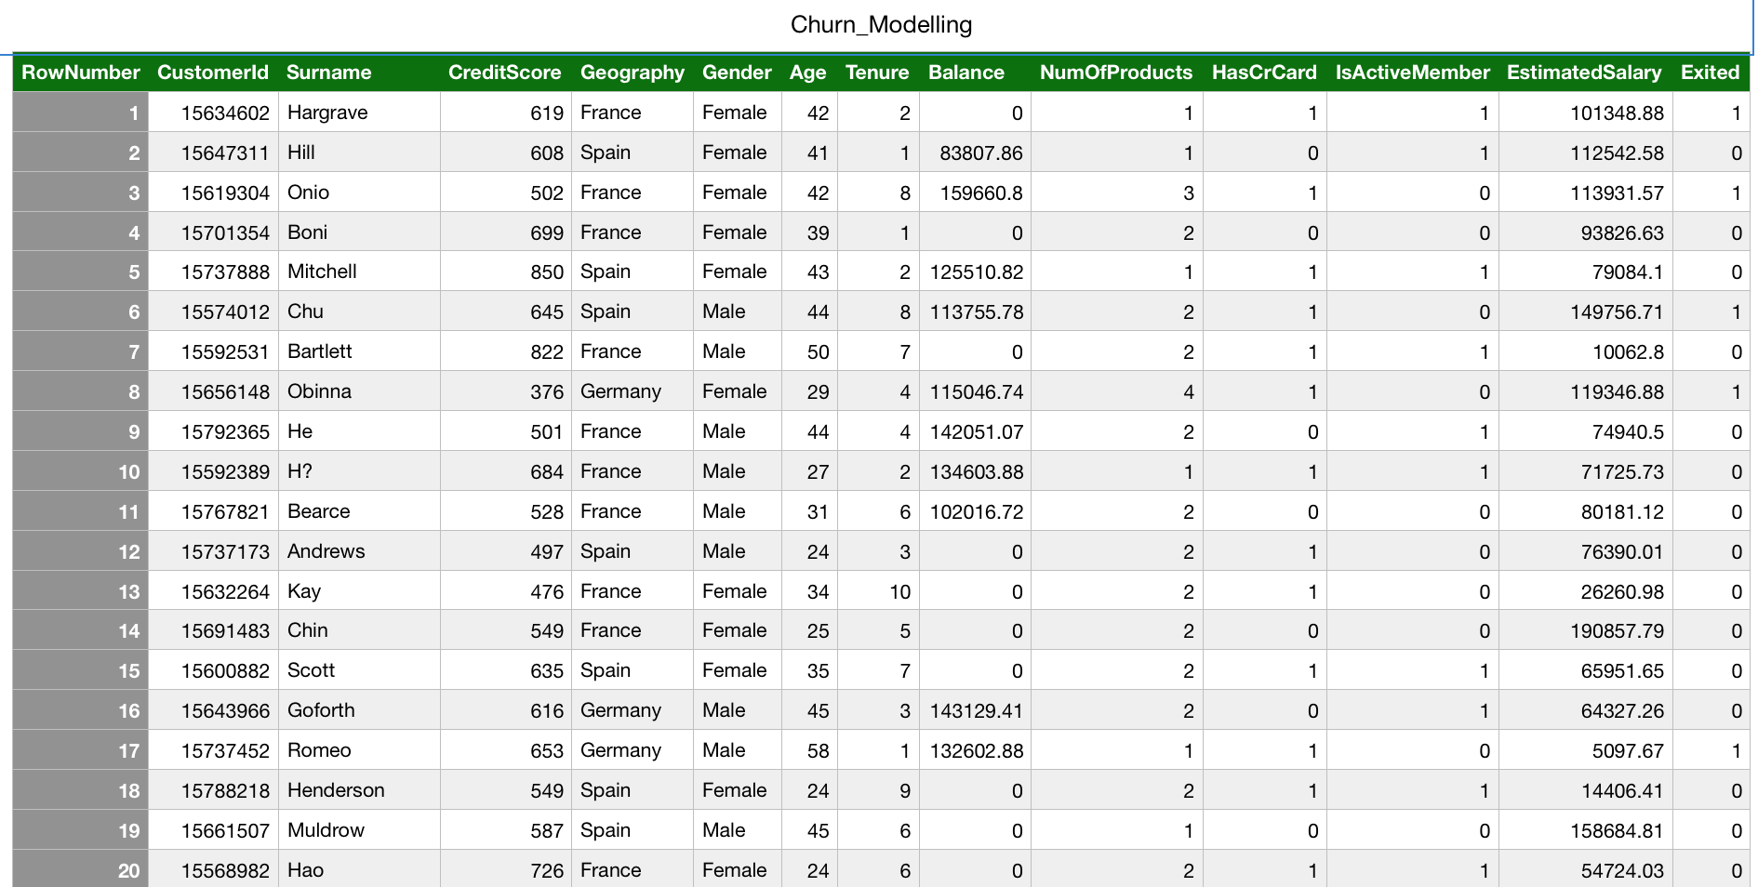
Relevent Information
Notes:
This is our part of dataset. This is the information of a bank's customers. This bank is innominate, so we don’t know this bank’s name. The data is comprised of ...Number 1 represents that customers have left our bank in the past six months. 0 represents that the customer ultimately stayed in the bank. our purpose is use the dataset to help manager to analyse what are the characteristics of the customers will leave their bank in the future.

Slide 10
Descriptive statistics and pre-processing
03

Slide 11
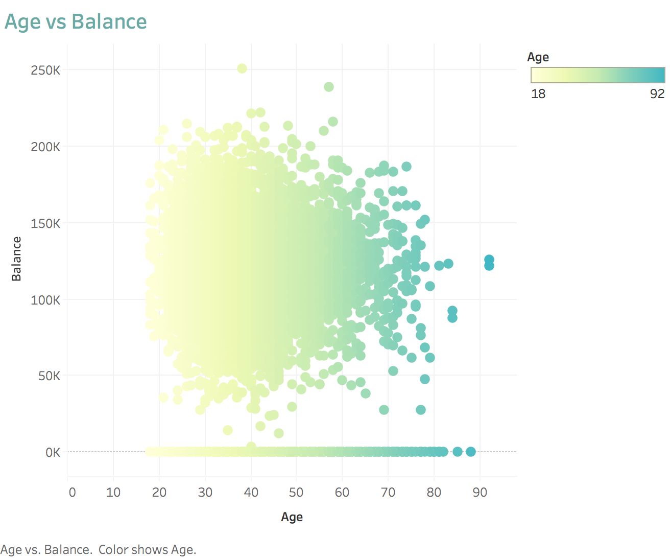
Descriptive Statistics
Age-Balance
MEAN 650.5288
SD
96.6533
MEAN
76485.89
SD
62397.41
MEAN 39
SD 10
CreditScore
Age
Balance

Slide 12
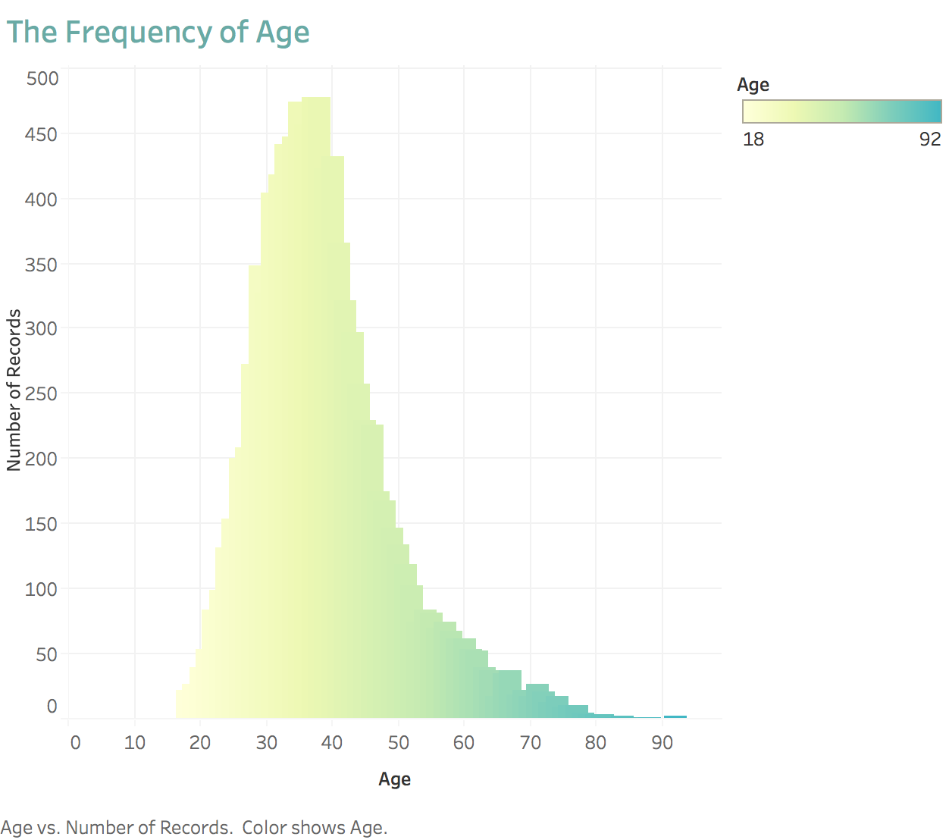
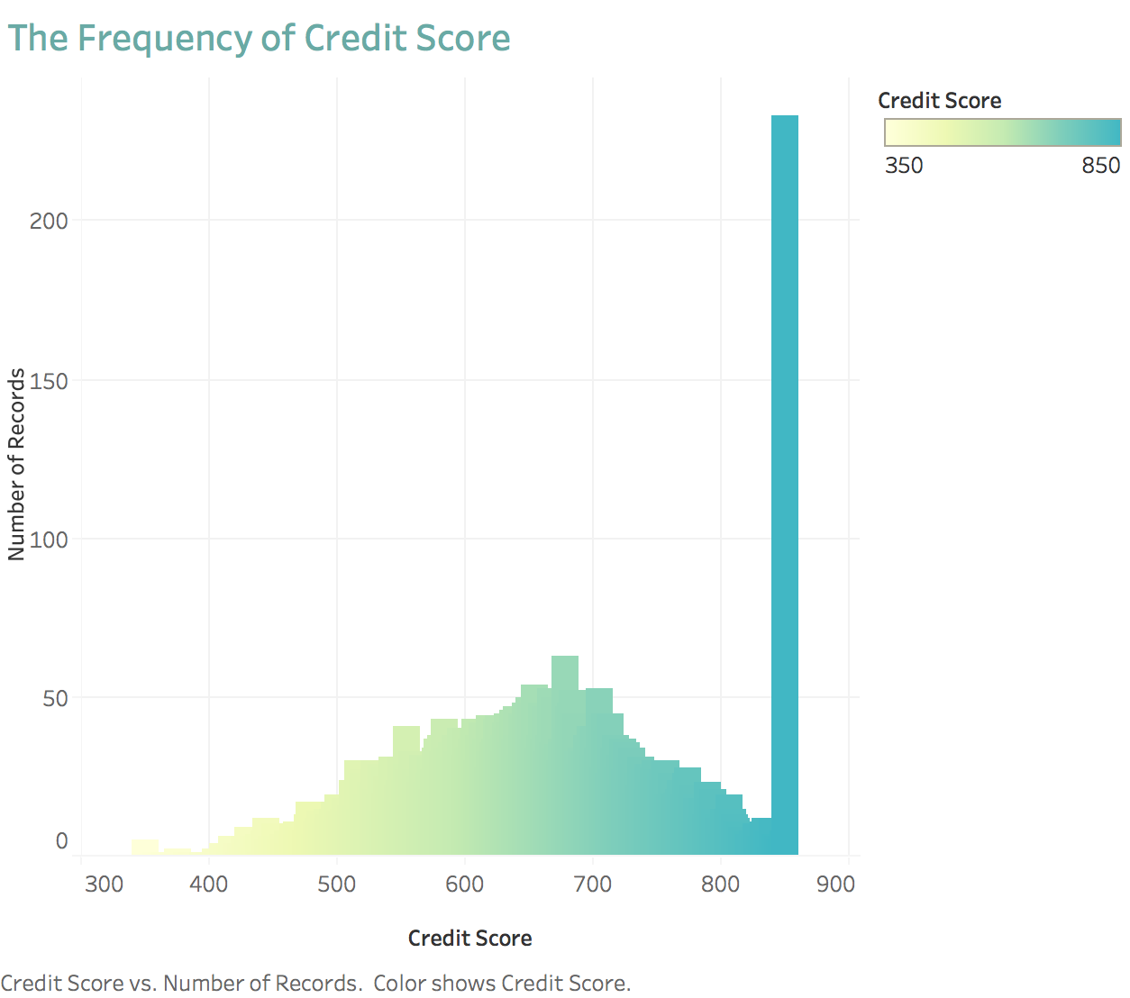
Distribution

Slide 13
Methods and Results
04

Slide 14
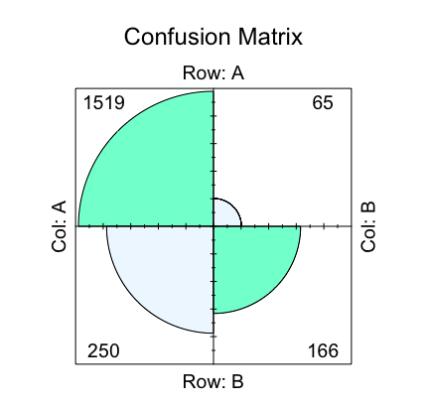
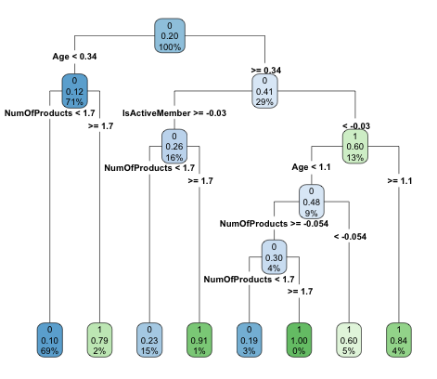

Decision Tree Before Prune
Accruacy
(1519+166)/1999=
84.29%
Notes:
Client whose age is below 43 years old, owns less than three kinds of products from the bank might exit in the future.
Client whose age is equal or greater than 43 years old, stays his status as an active member, but owns less than three kinds of products from the bank might exit in the future.
Client whose age is equal or greater than 43 years old but less than 50 years old, not an active member to the bank, owns less than three kinds of products from the bank might exit in the future.

Slide 15

Decision Tree After Prune
Accruacy
(1519+166)/1999=
84.29%

Slide 16
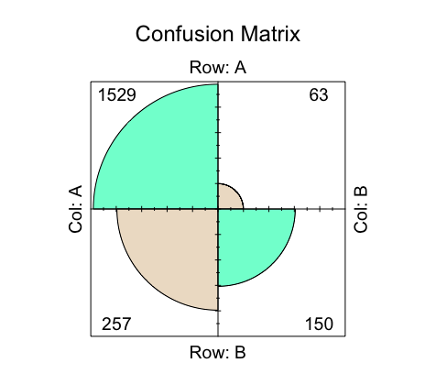
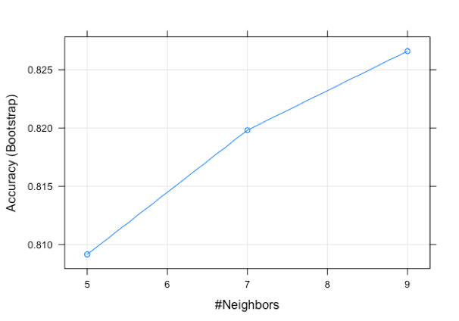
KNN
Accurancy
（1529+150)/1999=
83.992%

Slide 17
Dimensionality Reduction
Principal Componet Analysis
01
Record X as a matrix containing all m independent variables, and feature scaling X
When the dataset has many independent variables, PCA can extract new independent variables from all old independent variables, which can better explain the difference of data independent variables, regardless of the number of dependent variables.
02
Calculate the variance matrix of X. And write this matrix down as A
03
Calculate eigenvalues and eigenvectors of matrix A
Unsupervised Learning Model
04
Choose the percentage of variance that can be explained
Notes:
In order to improve the model’s accuracy, we reduce our dataset’s dimensionality. Firstly, we need to know what is dimensionality reduction? We can think of Dimension reduction is to reduce the number of independent variables. However, why do we want to reduce the dimension of the independent variable? The first advantage is that we can simplify our problems and make the fit well. For example, in multiple linear regressions, we don't need all the independent variables in many cases. Sometimes, we just need to figure out the most important independent variables and do our regression problem. In addition, when we reduce the number of independent variables, it is also conducive to our visualization results. For example, our dataset has eight variables, and it is difficult to present them on two-dimensional images. This is why we reduce the dimensionality of independent variables. Now let's look at when we use PCA in datasets and then use KNN to predict. What will it happen?

Slide 18
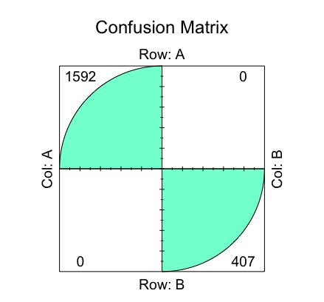
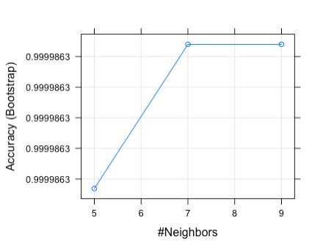
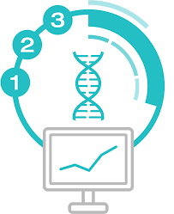
KNN After Principle Componet Analysis
Accurancy
(1592+407)/1999=
100.00%
Notes:
We can see that after using PCA, our accuracy is improved from 83% to 100%. In this case, our result of optimization is very well. when our number of independent variables is reduced, our accuracy can be improved.

Slide 19
Conclusion
05

Slide 20
Data Analysis Process
Collect data
Check the distribution
Decision tree
KNN
Principal Componet Analysis
The goal of the data
Mean
SD
Find out the key factor
Check the accuracy
Improve the accuracy

Slide 21
Conclusion
Future discussion
Purpose
Implication
KEY FACTORS:
age
status
number of products
Help banks to find out key factors which will affect customers to stay or exist and improve customer service.
Sell a variety of financial products to customers.
Increase the number of active member.
Pay more attention to the clients whose age from 42 to 50.

Slide 22
Questions ?
Thanks for your watching!

